Slide 1


Lesson 1
Introduction to Coding
csinschools.com

Slide 2



Learning objectives
By the end of this lesson, you should be able to:
access the course resources, and have them working
play a text adventure game
understand what a programming language is
write your first program!
play a game and explore how to modify it
2

Slide 3
Introduction Worksheet & Scavenger Hunt
Make a copy and complete this worksheet
Complete it by yourself, or together as a class
When you're done, share what you wrote with the person next to you
Review as a class
3

Slide 4

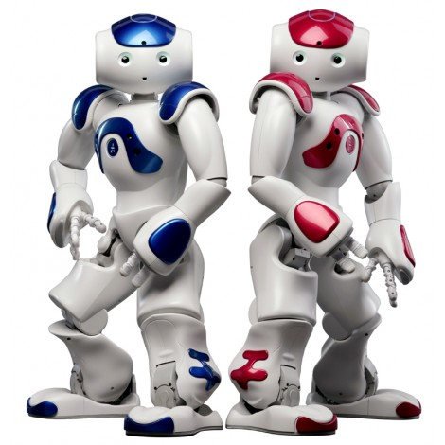

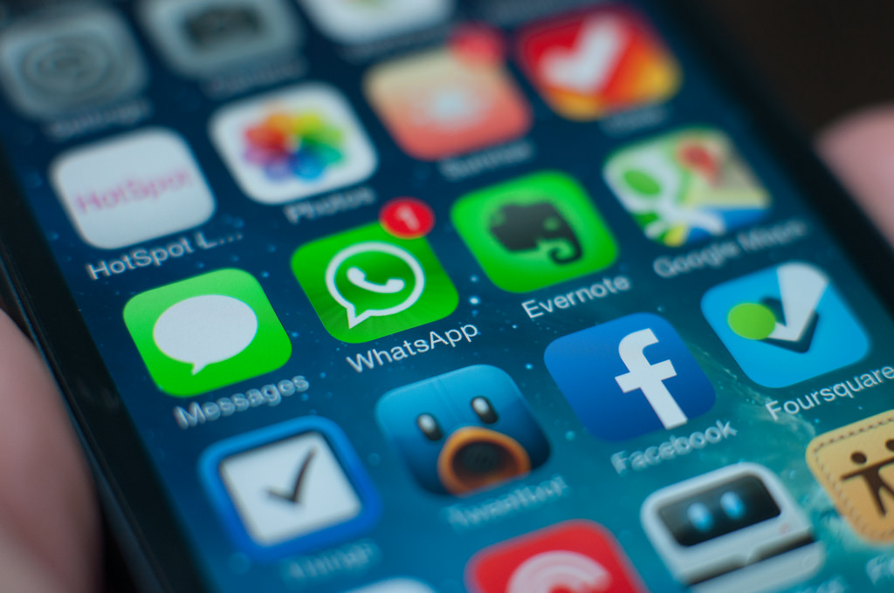

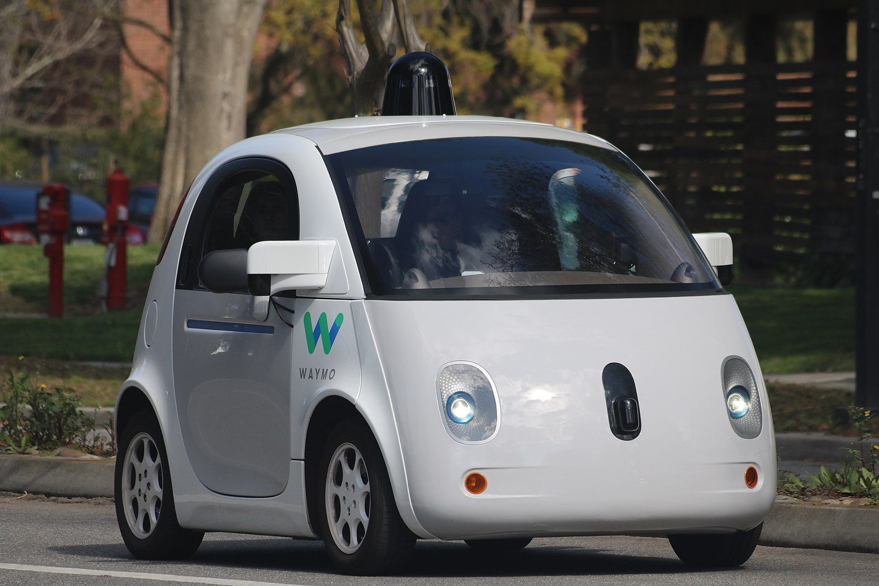
What can you produce by coding?
Software that drives cars
Instagram, Snapchat, and TikTok
Online shopping apps
Study tools
Hairstyling simulations
Games
Smart robots
… and loads more!
4

Slide 5

Have you ever...
Had a cool idea for a new app or website?
Have you ever wanted to:
create amazing new photo and video filters and apps?
cure cancer or be on the forefront of scientific discoveries?
make smarter robots or self-driving vehicles?
make your own website to buy and sell clothes?
make video games as your career?
Have you ever wanted to understand how computers and machines seem to be able to learn and "think"?
5

Slide 6



Skills that you will develop as you learn how to code
Analysing and solving complex problems
Being confident at using and building things using a computer
Being resourceful, investigative, and creative
Making maths come alive
Communication and technical writing
Working in teams
Resilience
6

Slide 7


Demo: City of Gold!
Click here to play a Text Based Adventure Game - just like your assignment!

Slide 8

How computers work
Computers can operate very fast
However, they need to be told what to do
They need instructions that are step-by-step
They do exactly as they are told
When we give instructions to a computer, we must also communicate in a language that the computer understands
There are many languages that have been invented for computers
What computer "programming languages" do you know?
8

Slide 9

Using the Python programming language
We are going to use the Python programming language in this class
Python looks like English and is quite readable
There are lots of code already written in Python that you can reuse in your own programs
Python is the most popular programming language in industry
It is used in companies such as Google, Facebook, Amazon, and Microsoft, as well as many schools and universities around the world!
It does require typing though. It may be trickier to get started than some other languages (such as Scratch), but soon enough, you will be able to do things much more quickly!
9

Slide 10
Your first Python program
print("Hello, world!")
10

Slide 11
Your first Python program
print("Hello, world!")
This is a command. It's one of the ways we can tell the computer to do something in Python!
11

Slide 12
Your first Python program
print("Hello, world!")
This is a command. It's one of the ways we can tell the computer to do something in Python!
In this case, we're telling it to print something, which means to display some text in the console.
12

Slide 13
Your first Python program
print("Hello, world!")
This is the text we want to print. We put it inside round brackets ( ) so that Python knows this is all we want to print.
13

Slide 14
Your first Python program
print("Hello, world!")
This is the text we want to print. We put it inside round brackets ( ) so that Python knows this is all we want to print.
14

Slide 15
Your first Python program
print("Hello, world!")
So that Python knows this isn't code, we also put the text inside quotation marks.
15

Slide 16
Your first Python program
print("Hello, world!")
So that Python knows this isn't code, we also put the text inside quotation marks.
We've used double quotes " " here, but you can use single quotes ' ' if you like!
16

Slide 17
Your first Python program
print('Hello, world!')
So that Python knows this isn't code, we also put the text inside quotation marks.
We've used double quotes " " here, but you can use single quotes ' ' if you like!
17

Slide 18
Your first Python program
print("Hello, world!")
Let's run this code to find out what it does! We'll see the output of our program in the console on the right hand side.
18

Slide 19
Your first Python program
Hello, world!
print("Hello, world!")
19

Slide 20
Your first Python program
Hello, world!
print("Hello, world!")
Awesome! We got Hello, world! as our output!
Notice how the quotation marks don't appear.
20

Slide 21
Your first Python program
Hello, world!
print("Hello, world!")
Awesome! We got Hello, world! as our output!
Notice how the quotation marks don't appear.
21

Slide 22
Your first Python program
Hello, world!
print("Hello, world!")
22

Slide 23
Your first Python program
Hello, world!
print("Hello, world!")
All done!
23

Slide 24



Activity: Hello World!
Helpful Hints
This is your very first program!
You’ll need to use:
print()
Activity 01.02 Hello, World!
24

Slide 25

Activity: Hi to You!
Helpful Hints
Now, remember your quotation marks!
You’ll need to use:
print()
Activity 01.03 Hi to You!
25

Slide 26
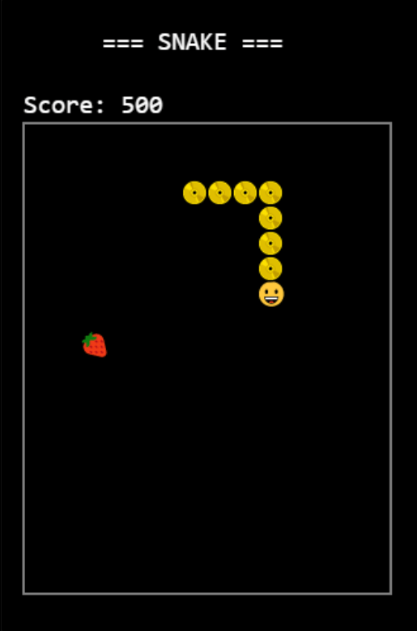
Extension Activity: Snake!
Tutorial Video
Need some help?
Watch the tutorial video.
Snake is a classic game that you can make with Python!
Watch this video, and then try the game and edit the code here!
26

Slide 27


Reflection: Exit pass
What is one new thing you learnt today?
Write it on a sticky note and stick it on the board before you leave the classroom
27

Slide 28
License Information
These CS in Schools lessons plans, worksheets, and other materials were created by Toan Huynh and Hugh Williams. They are licensed under a Creative Commons Attribution-ShareAlike 4.0 International License.
Images, in order of appearance:
"Video Conference 1" by Freepik on Flaticon
"Video Conference 2" by Freepik on Flaticon
"Waymo self-driving car front view" by Grendelkhan is licensed under CC BY-SA 4.0
"NAO Robot (bleu et rouge)" by Softbank Robotics Europe is licensed under CC BY-SA 4.0
"iOS7 Homescreen blurred (DSC_0719)" by Jan Piersel is licensed under CC BY-SA 2.0
"Fortnite Battle Royale Receives New Snipers-Only Mode" by BagoGames is licensed under CC BY 2.0
"Silhouette Teamwork Isolated Computer Man Business" is licensed under CC0 1.0
"Yeah!! text" by rawpixel on Unsplash
28

